Slide 1
Beyond Moore’s
Law: VLSI Design
in the Era of
More-than-Moore
Course: WS2025 ELE Advanced Hardware Engineering
Professor: Prof. Dr.-Ing. Ali Hayek
By: Ikramul Hassan Sazid

Slide 2
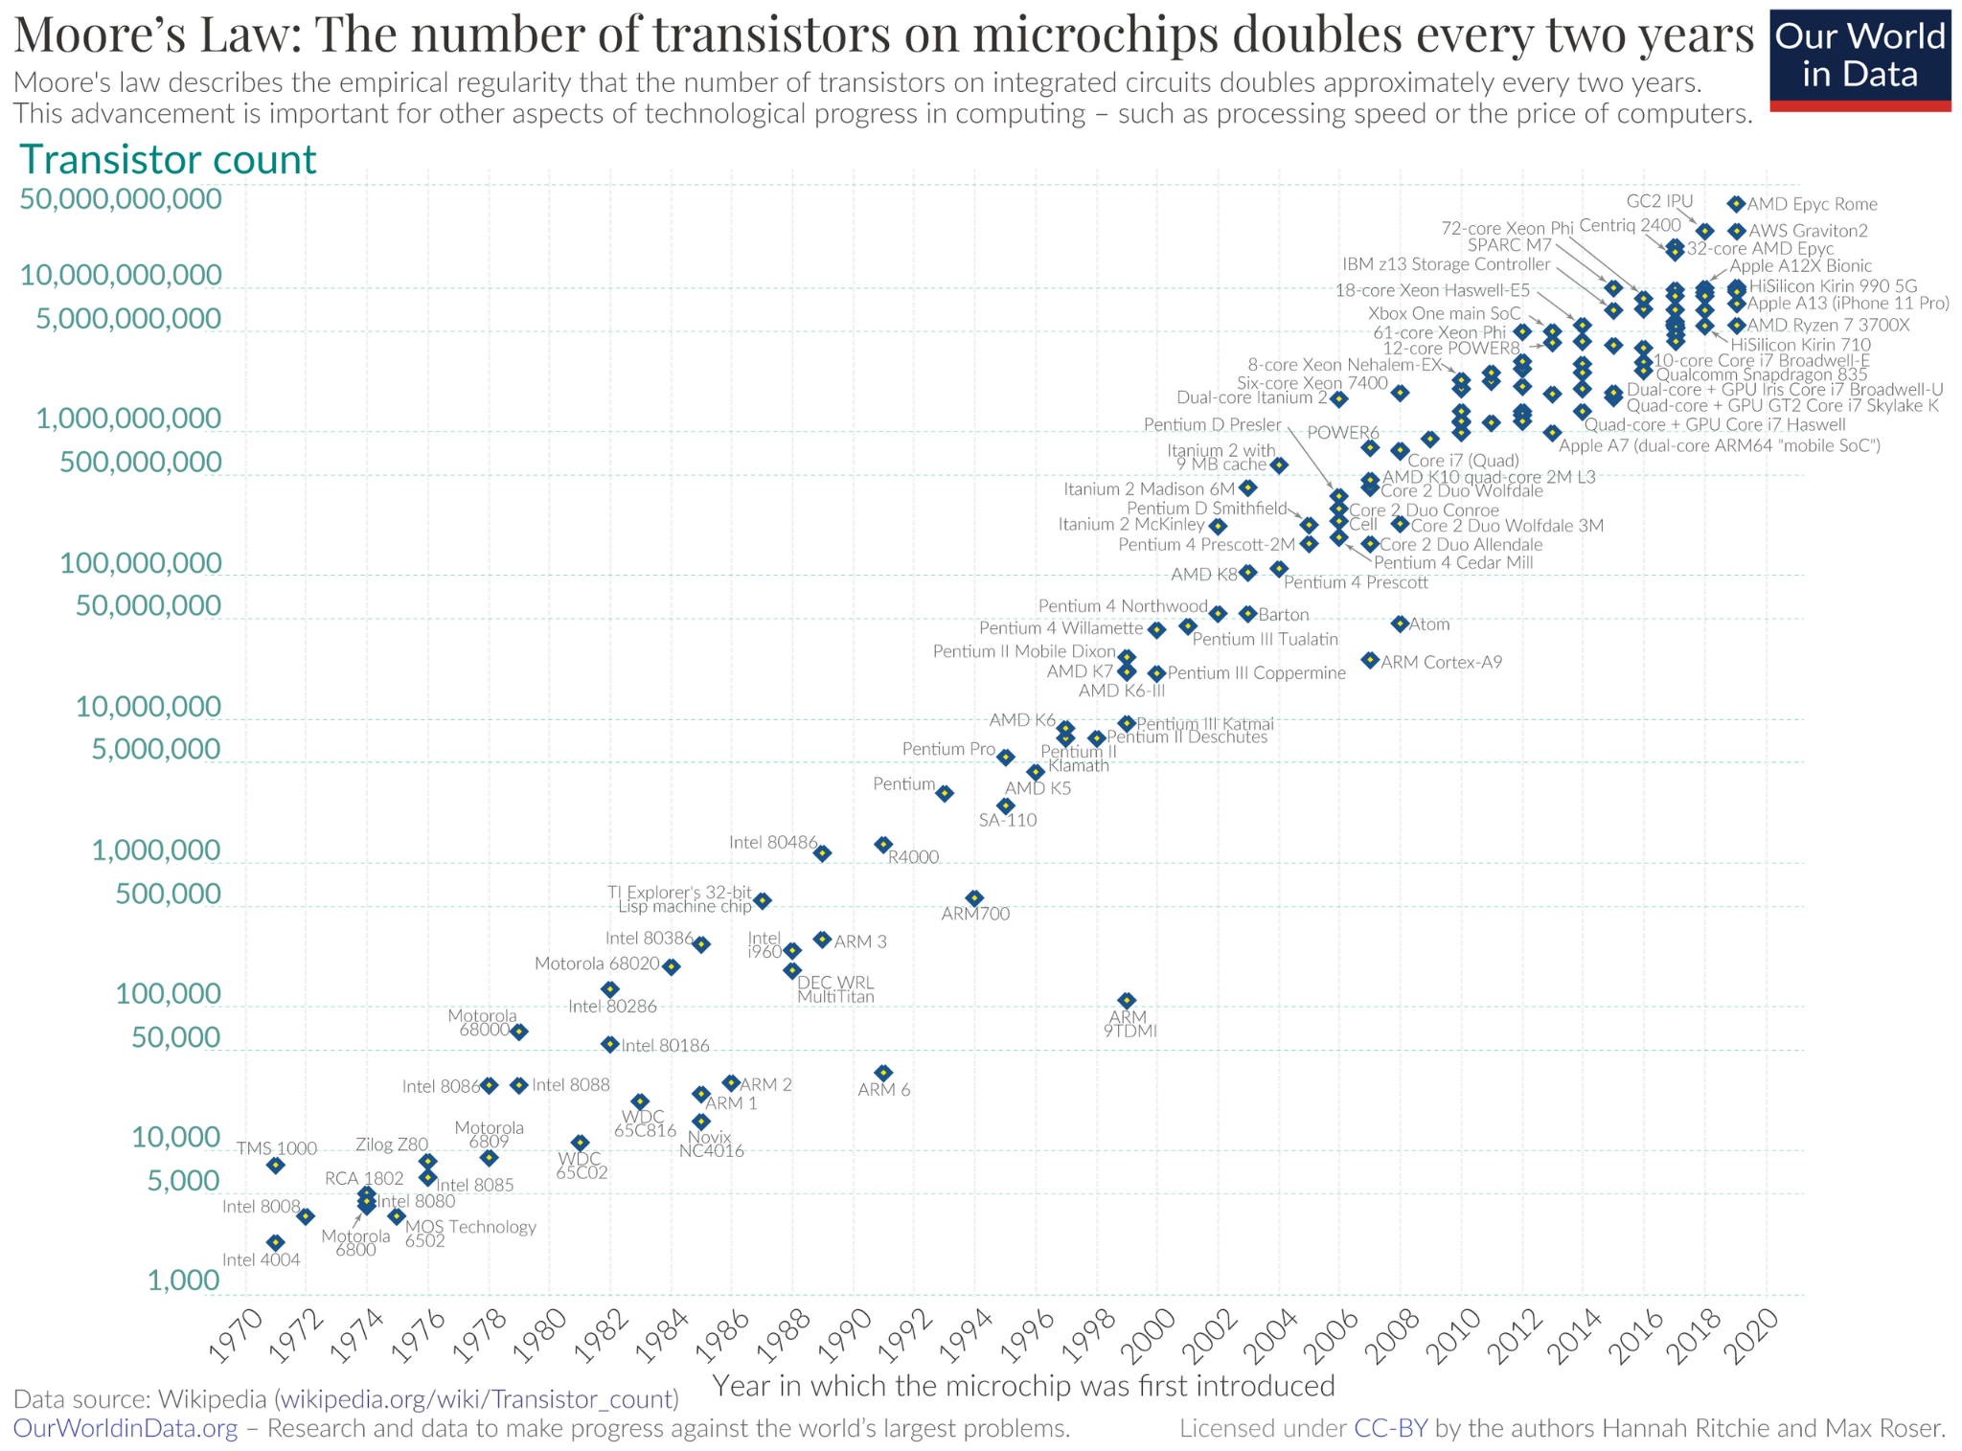
BACKGROUND: THE END OF MOORE’S LAW
Gordon Moore, co-founder of Fairchild Semiconductor and Intel, predicted in 1965 that transistor doubling would continue for a decade

Slide 3
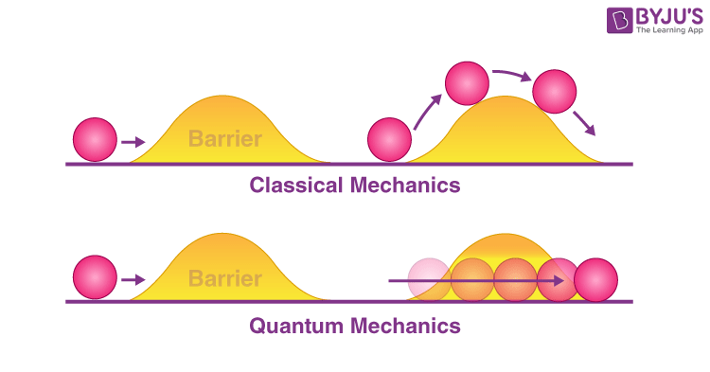
Quantum Tunnelling
IC technology pushes the boundaries of
physics. The gate distance in transistors has become so small that charge-carrying electrons can pass through unintended channels

Slide 4
More Than Moore (MtM): A new Era
A different approach to semiconductor innovation
MtM focuses on:
Parallel functional diversification,
Heterogeneous integration
system-level innovation.
integrate both digital and non-digital functionalities (RF, power
sensors, actuators, mixed-signal components

Slide 5
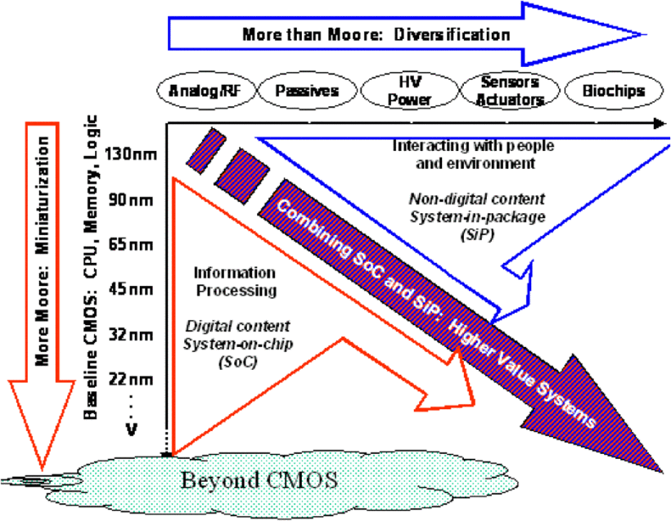
More Than Moore (MtM): A new Era
A different approach to semiconductor innovation

Slide 6
Key Directions in MtM
A different approach to semiconductor innovation
MtM focuses on:
3D ICs and TSVs
Heterogeneous integration
Advanced Devices ie. Reconfigurable Field Effect Transistors (RFETs)
integrate both digital and non-digital functionalities (RF, power, sensors, actuators, mixed-signal components
System-in-Package (SiP)
Chiplet-Based Architectures

Slide 7
SYSTEM-ON-CHIP (SOC) AND SYSTEM-IN-PACKAGE (SIP)
Heterogeneous integration of logic, memory, RF, MEMS, and optical components
Smaller size
Lower cost
Faster time to market by leveraging commercial off-the-shelf components.

Slide 8
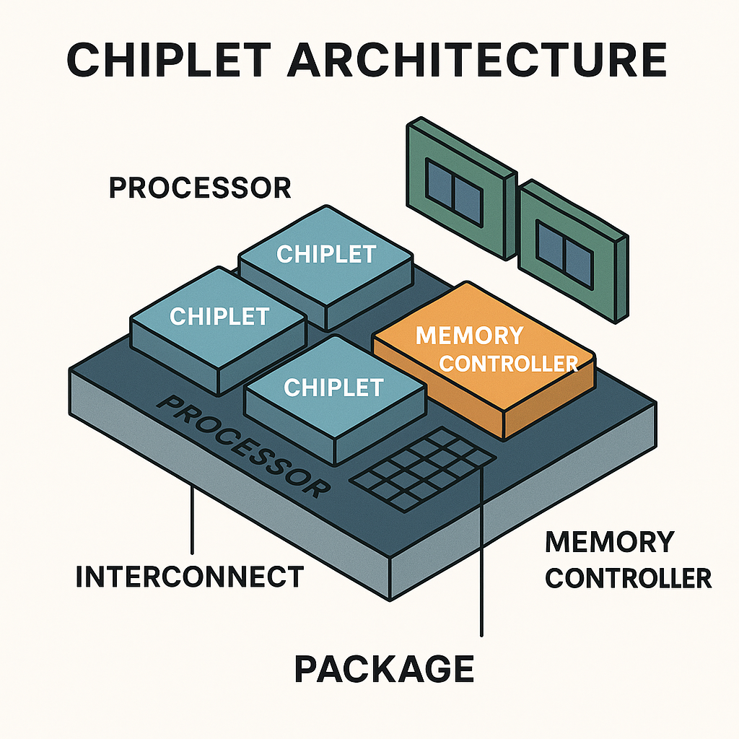
CHIPLET-BASED ARCHITECTURES
Multiple small chips for different functions (chiplets) Instead of monolithic chip
enables designers to develop highly customized systems for different functionalities
Highly re-usable chiplets

Slide 9
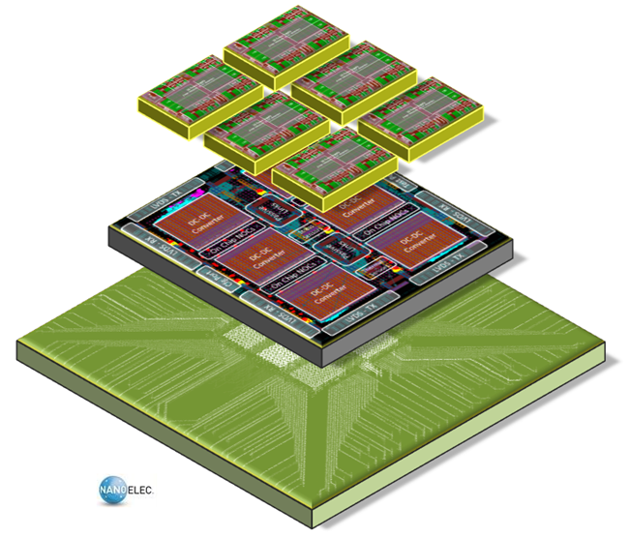
Focus Direction: 3D ICs and TSVs
Greater Density and Functionality
Performance and Bandwidth by facilitate TSVs, reducing lengths of interconnects
Reduction of Power consumption
Thermal Management

Slide 10
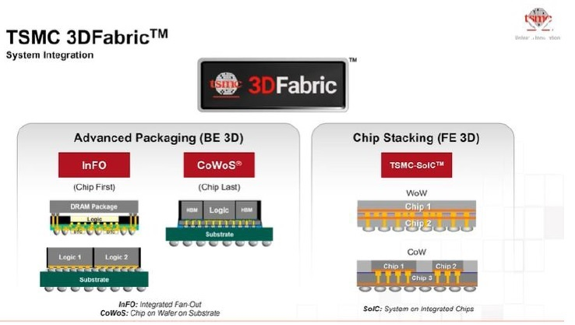
Focus Direction: 3D ICs and TSVs
This technology enables integrating multiple dies into a single package
High bandwidth
for HPC
AI Application

Slide 11
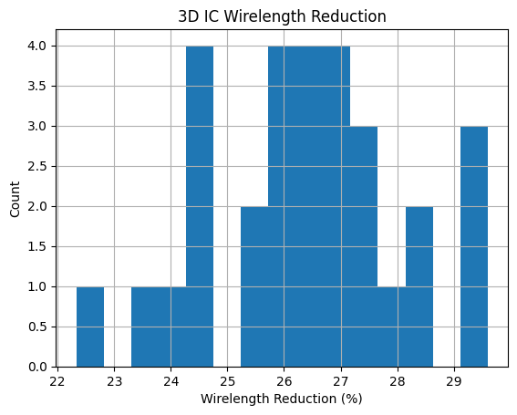
SIMULATION AND ANALYSIS
Effect of 3D integration on wirelength and signal delay
Methodology:
Utilized a Monte Carlo simulation framework. The simulation reflects the
transition from a standard 2D planar architecture to a 2-tier 3D IC
Wirelength Reduction (26.41%):
A considerable
amount of reduction in the global wirelength was ob-
tained by the 3D floorplanning

Slide 12
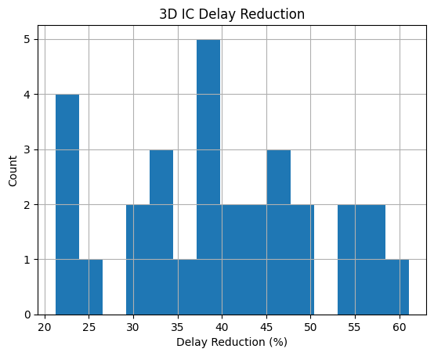
SIMULATION AND ANALYSIS
Effect of 3D integration on wirelength and signal delay
Delay Reduction (40.01%): Substantial acceleration, nonlinearly correlated to a decrease in wire-
length.

Slide 13

Conclusion

Slide 14
References
[1] J. McMillan, “Understanding 3D IC Technology: Unveiling the Future of Integrated Circuits,” Siemens Digital Industries Software Blogs, Nov. 6, 2023. [Online]. Available: https://blogs.sw.siemens.com/semiconductor-packaging/2023/11/06/understanding-3d-ic-technology-future-integrated-circuits/
[2] P. Ramm, A. Klumpp, J. Weber, and M. M. V. Taklo, “3D System-on-Chip technologies for More than Moore systems,” Microsyst. Technol., vol. 16, no. 7, pp. 1051–1055, Jul. 2010, doi: 10.1007/s00542-009-0976-1.
[3] J. P. Kent and J. Prasad, “Microelectronics for the real world: Moore versus More than Moore,” in Proc. 2008 IEEE Int. Symp. Semicond. Manuf., Santa Clara, CA, USA, 2008, pp. 1–4.
[4] Himanshu, “Breaking the Monolithic: The Rise of Chiplet Architecture,” Medium, May 15, 2024. [Online]. Available: https://medium.com/@himanshu0525125/breaking-the-monolithic-the-rise-of-chiplet-architecture-bed913a959d6. [Accessed: Dec. 18, 2025].

Slide 15
Thanks!
Do you have any questions?
Please keep this slide for attribution

